Slide 1

EFFECTIVE SAFETY COMMITTEES

Slide 2
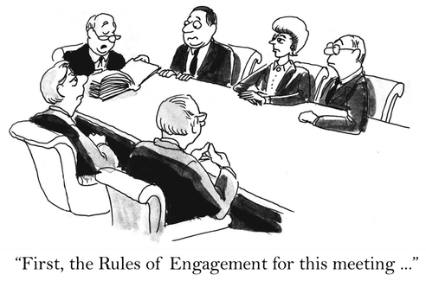
What is a Safety Committee?
A safety committee –A representative sample group of people organized together from different areas of a workforce tasked to improve the occupational safe working conditions of that workforce and facility.

Slide 3
Roles of safety committee
Know the feelings and thinking of employee by survey and interview
Analyze the behavior of employee by observing
Do safety inspections at workplace
Do safety audits
Control measures and safety improvements measure should be monitored
Evaluate quality of safety culture in long terms
Develop and submit the written recommendations

Slide 4

Purpose of safety committee
Help protects employee by providing knowledge of safety
Helps protect employee by providing a solution to issues
Bring together labor and management for health and safety
Help the employee give training to manager , supervision and workers for better hazard identification and control and health and safety performance

Slide 5
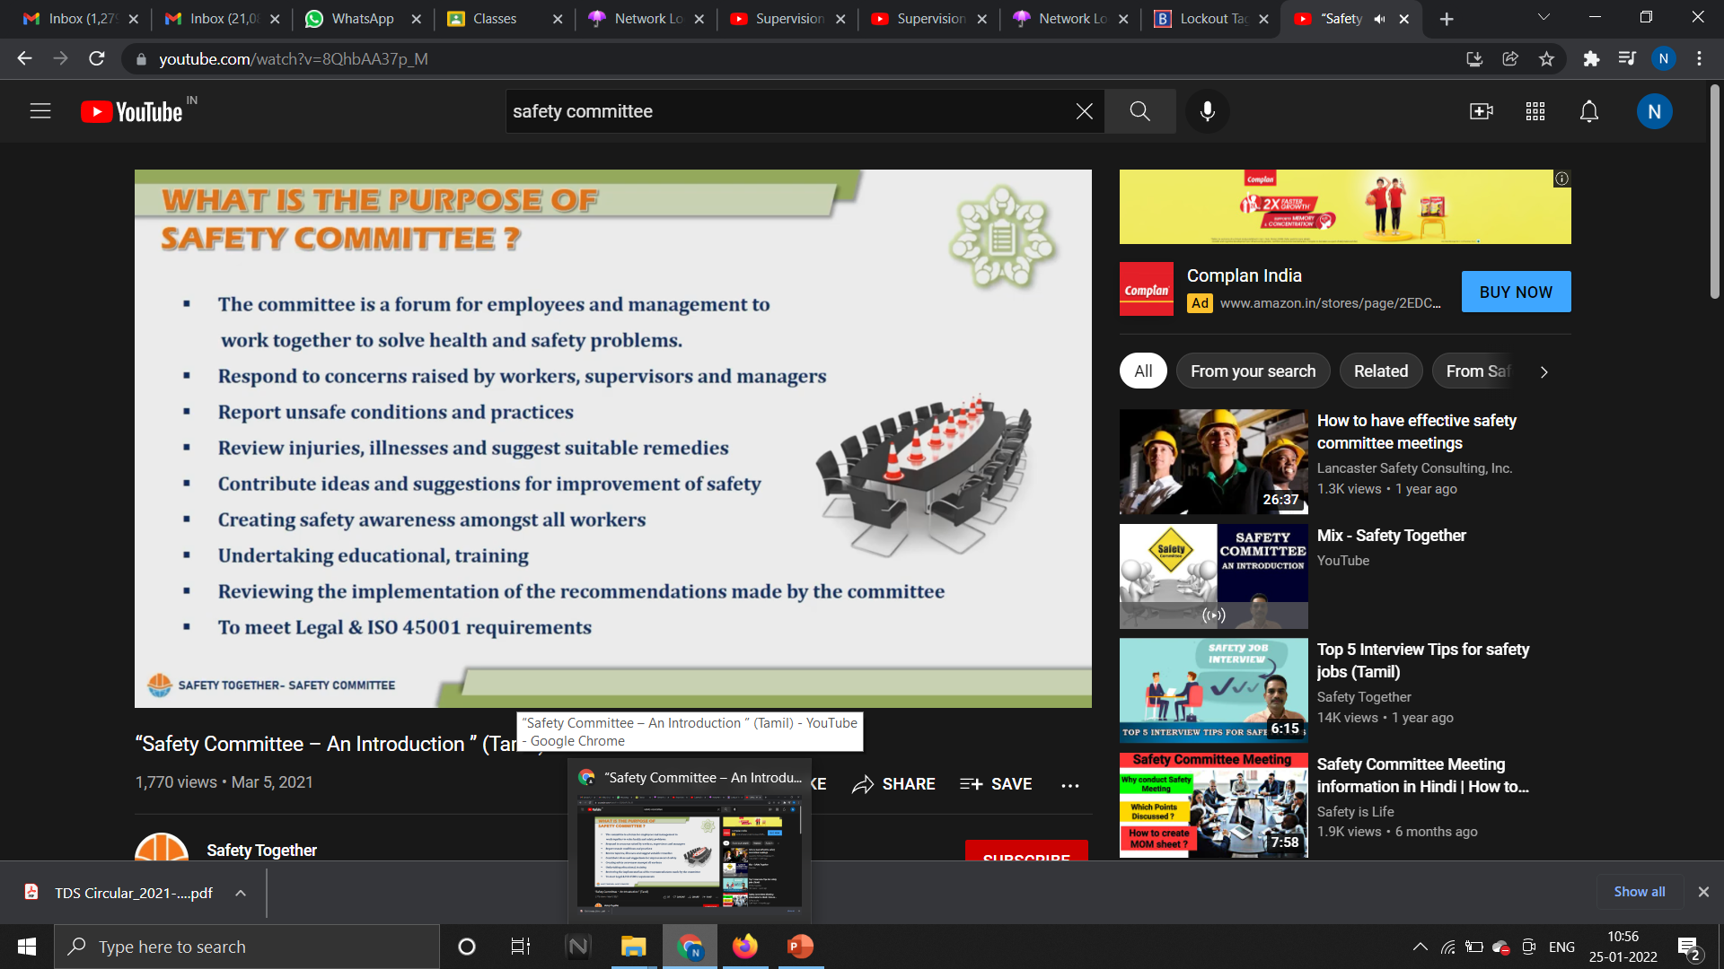

Slide 6
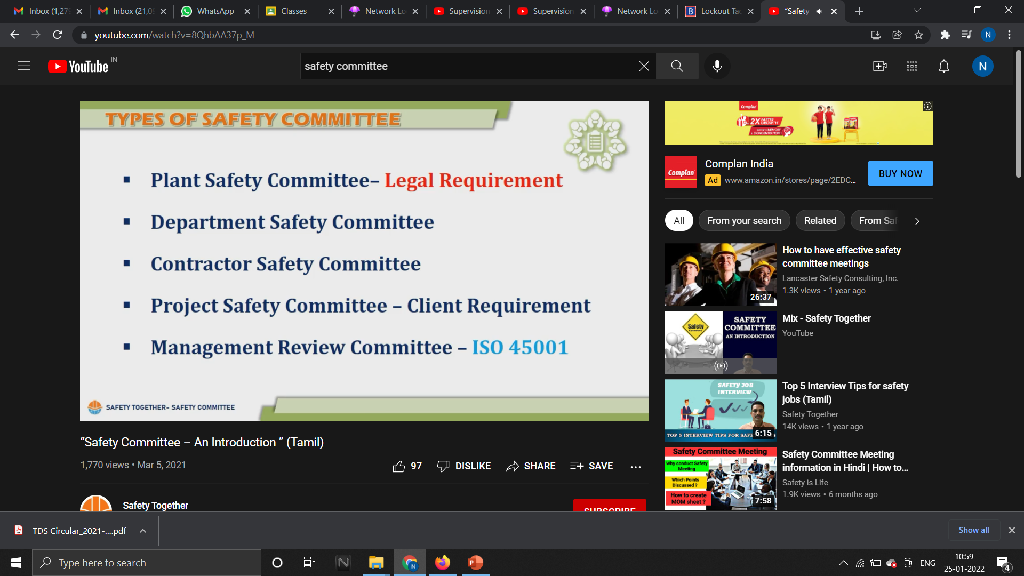

Slide 7

Functions of safety committee
To have knowledge on
Skills
Abilities
of health and safety

Slide 8
Benefits of safety committee
Identify hazards
protect employee and employer
Communication between labor and management

Slide 9
Duties of safety committee members
Receive concerns , reports and suggestions by employees and give them to manager level and give the management level response to employees
Workplace inspection
Receiving training
Attending meetings
Control measures and safety improvement progress
Monitoring
Hazard identification
communication

Slide 10
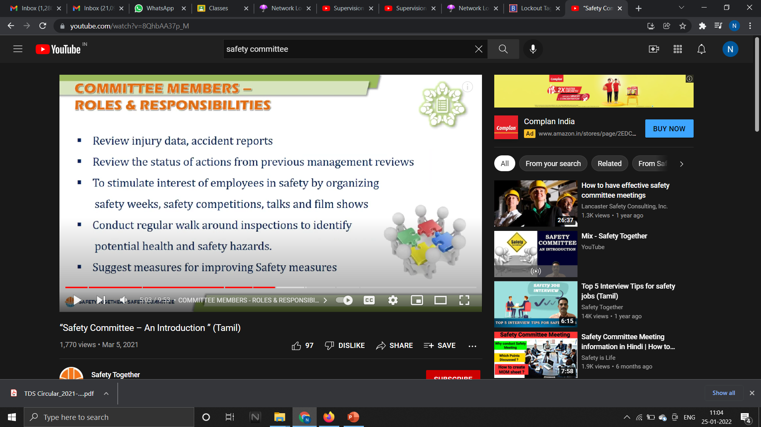

Slide 11
Benefits of training the safety committee
Know their purpose of job
Know the role
Know the function
Know the responsibility
Know the skills
Know the abilities
Know the information on health and safety
Hazard identification profit for company
Competition leading
Effective audit
Lower injury and illness rates

Slide 12
Three areas for effective safety committee training
Safety committee operations
Hazard identification and control
Accident investigation procedures

Slide 13
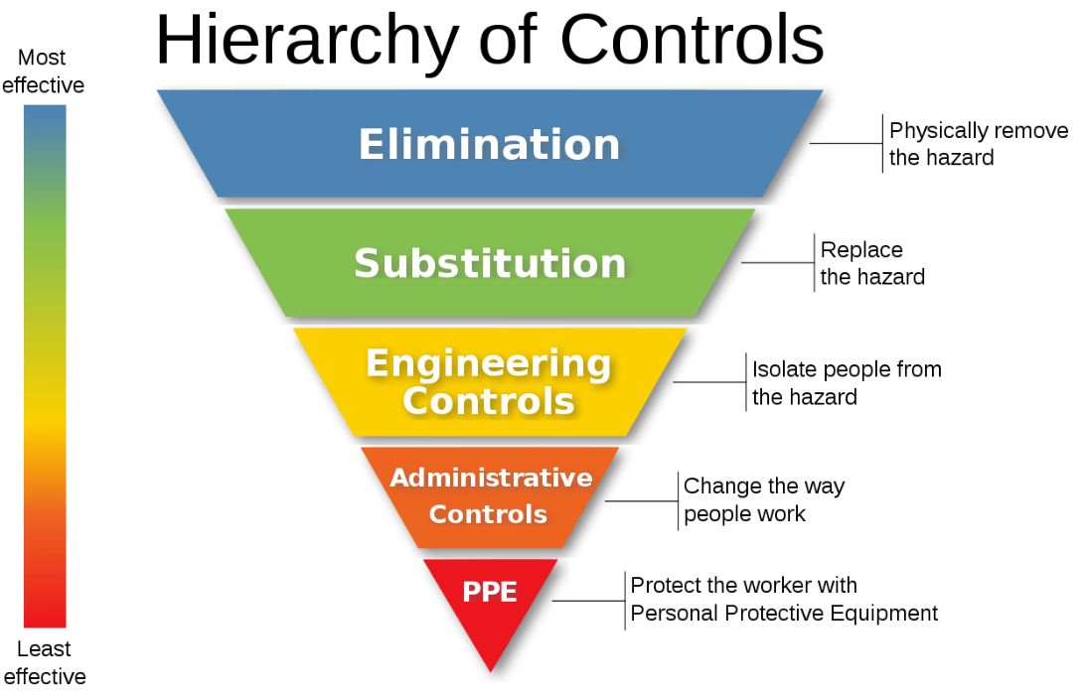
Hierarchy of controls
Engineering controls
Administrative controls
Personal protective equipment

Slide 14


Accident investigation procedures
Write data of accident
Know the surface and root causes
Make the report
Suggest safety measures

Slide 15
Causes of accident report failures
Surface causes are uncovered but , root causes are not uncovered
Hazardous conditions are uncovered
Unsafe work practices uncovered
Failure in safety management uncovered

Slide 16
Causes of majority injuries
Inadequate supervision ,education , accountability , and resources

Slide 17
Hazardous conditions
Material
Equipment
Environment
People
system

Slide 18

System design and implementation
Objectives
Policy
Plan
Procedures
Processes
Budget
Report
Rules

Slide 19


Safety inspection
In safety inspection we give time to know for a thorough inspection to be conducted to know what is happening

Slide 20

Job hazard analysis
Employee , managers together solve the problems

Slide 21
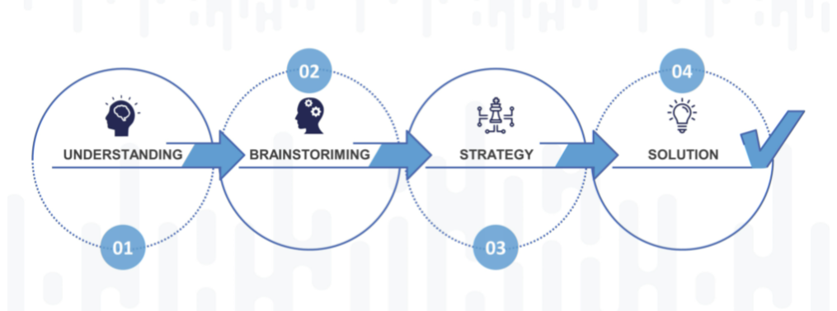
Problem solving techniques
Understand the problem
Discuss causes
Target solutions
Sell solutions
Implement solutions

Slide 22
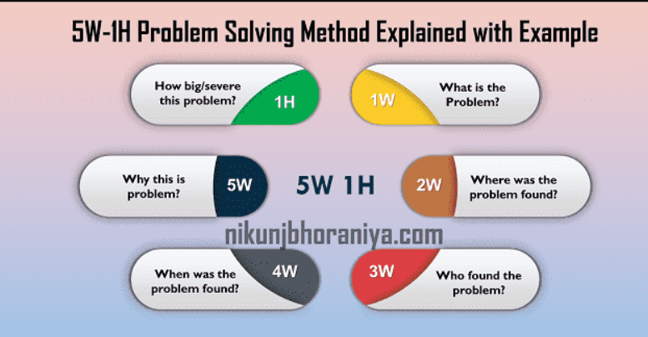
5 wh analysis
Who is getting hurt ?
What actually caused the injury ?
When workers are getting hurt ?
Where workers are getting hurt ?
How workers are getting hurt ?

Slide 23
How to conduct a survey
Gather a team of trained employees
Determine who you are going to sample
Decide how will you conduct the survey ?
Tell everyone why you are going to conduct survey ?
Conduct the survey
Summarize result
Discuss the result with CEO

Slide 24

Characteristics of an effective safety committee
Organized meeting
Good communication
Roles and purposes are understood
Standard of behavior
Objectives and completion dates are set
Members trained

Slide 25

https://www.convergencetraining.com/blog/how-to-make-safety-training-more-fun-and-engaging-tips-from-safety-managers

